Slide 2
Key Points Introduction:
Established in January 2021
Company located in Kuwait
Active in medical field at both private & government sectors
Number of staff is 12 employs for Service, Sales, admin & management
Specialized in several medical area, Digital Radiology, X-Ray dental & medical imaging, neuro surgery and dental products.

Slide 3
Departments Structure
Education & Marketing
Sales & Tendering
Regulatory Affair
Maintenance & After Sales

Slide 4







Partners

Slide 5
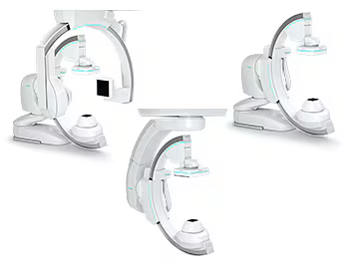
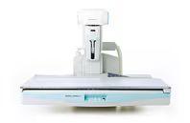
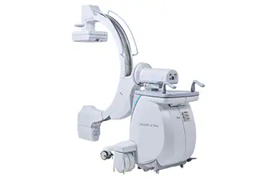
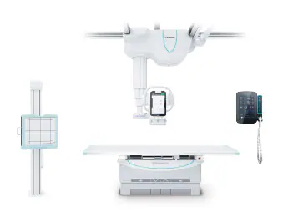
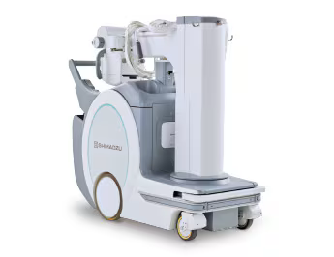
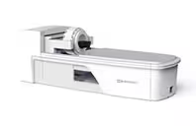
Medical Systems
Angiography
Fluoroscopy
Mobile C-arm
Radiography
Mobile X-ray
PET Scanner for Head & Breast

Slide 6
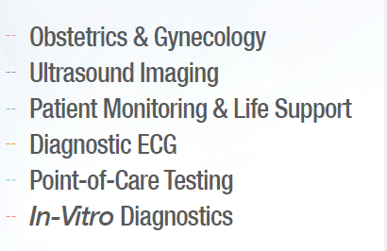

Products line

Slide 7
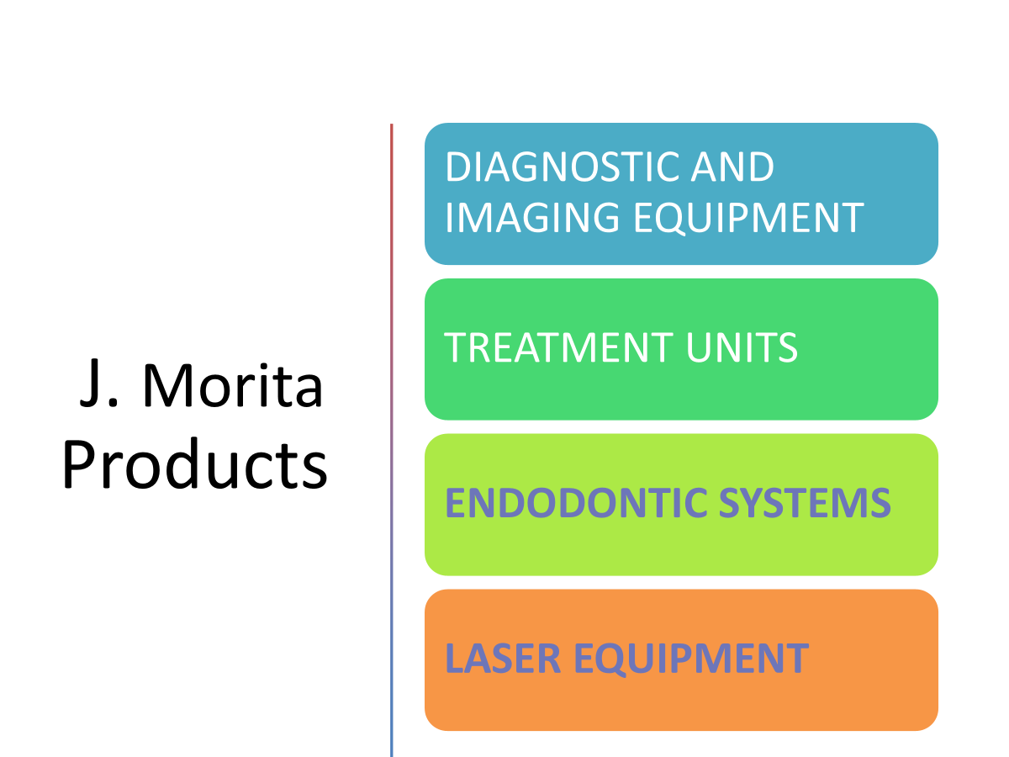

Slide 8
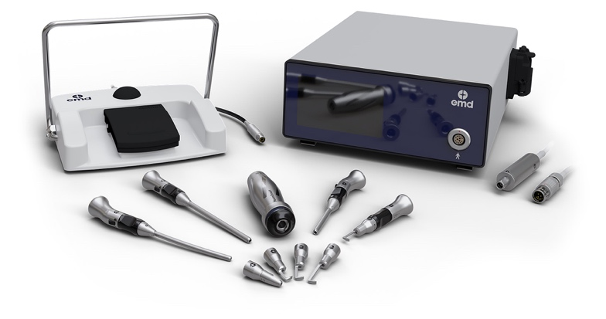
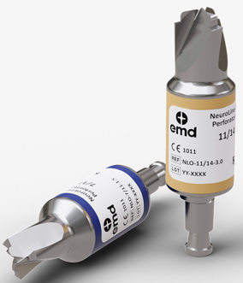
High speed drill
High speed drill by EMD for spine surgery and neurosurgical applications such as Craniotomy, Nazal trans Sphenoidal approach, Skull base surgeries, Endoscopic approaches for discectomy, laminectomy and others.
Cranial Perforator blade
Tow different types of Cranial perforator blades by EMD, disposable and reusable blades with different sizes and precise performance.

Slide 9
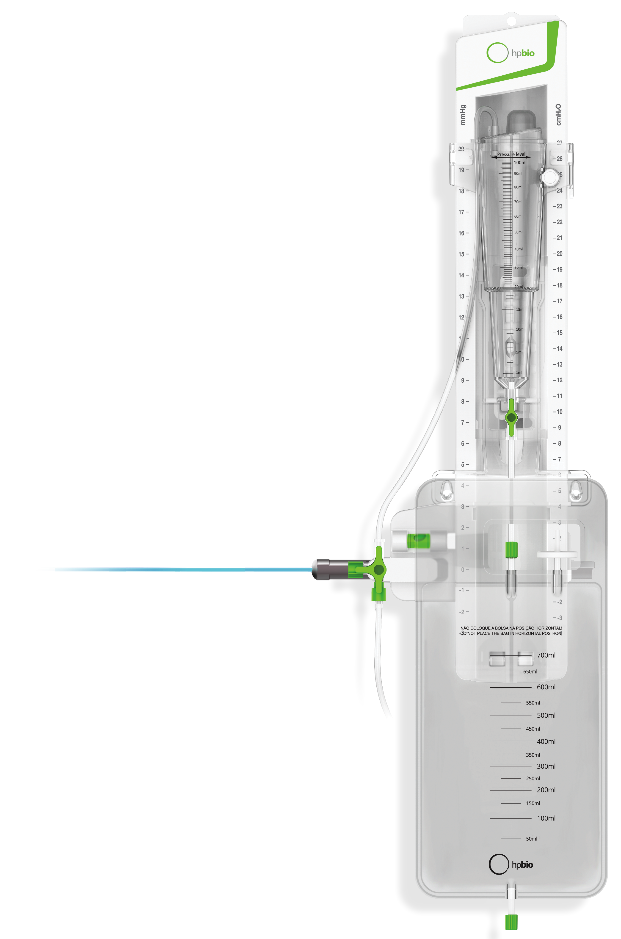
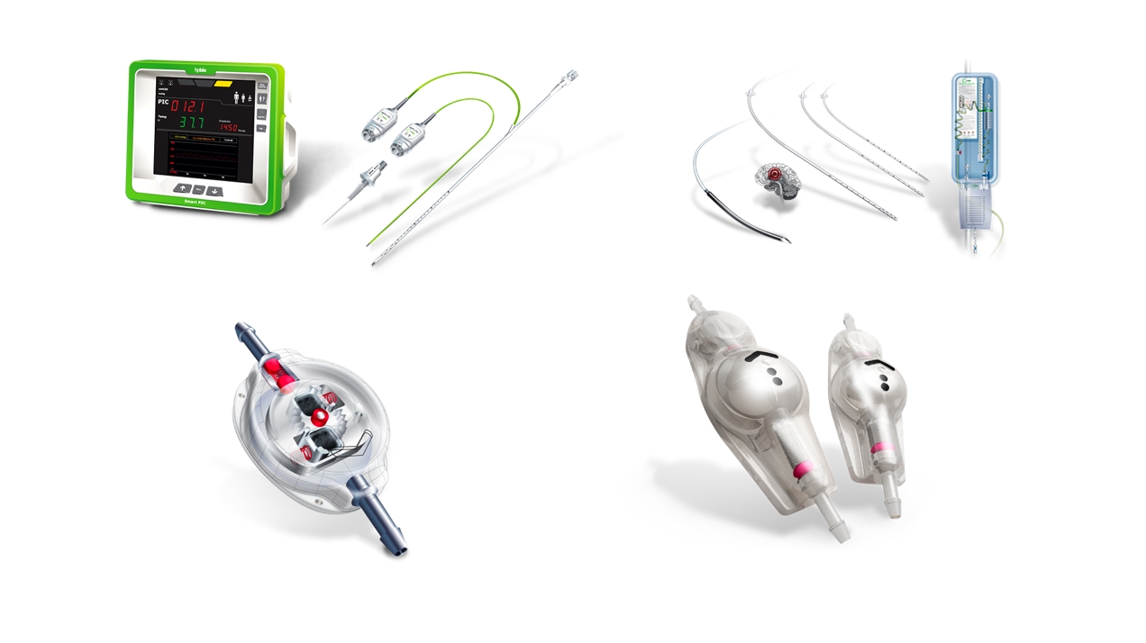
External Ventricular drainage
EVD by Hpbio provides External Ventricular Drainage system indicated for the reduction and temporary control of intracranial pressure, by cerebrospinal fluid drainage. The system gathers all the components required for a secure and efficient drainage.
Fixed and programable shunts
Different sizes and types of shunts by Hpbio provides CEREBRAL SHUNT SYSTEM with option of ANTI-SIPHON and options of HYDROCEPHALUS SHUNT SYSTEM or Programmable valve to control the introverticular pressure with hydrocephalus.

Slide 10

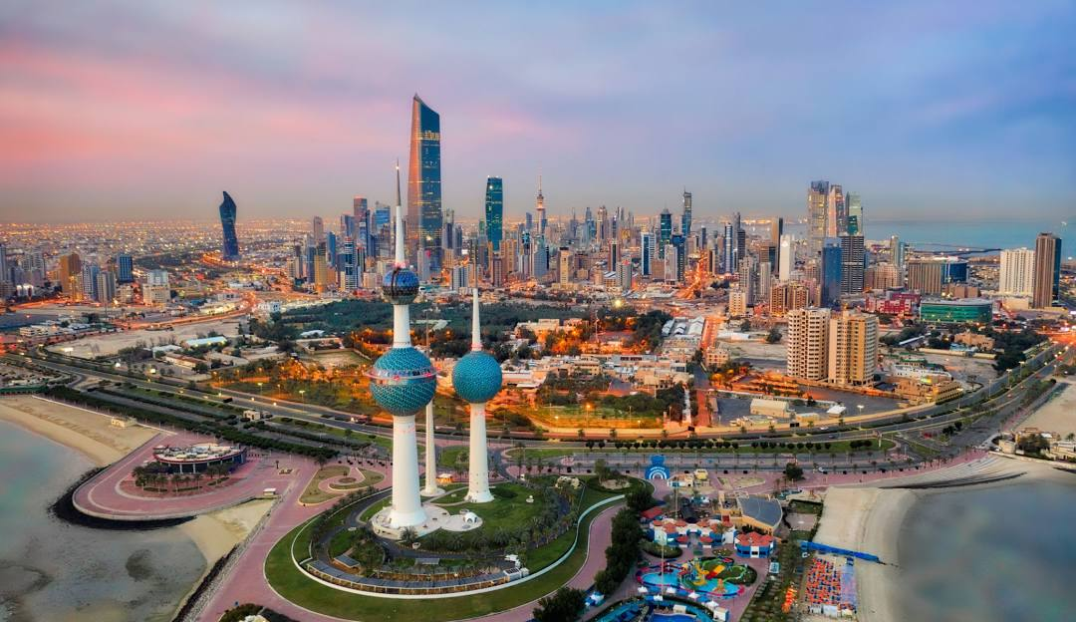
Kuwait – Market over view
Capital: Kuwait city
Currency: Kuwaiti Dinar 1KD ≈ 3$
Official language: Arabic
Population: 4.269 million (2022)
Area: 17,818 km²

Slide 11
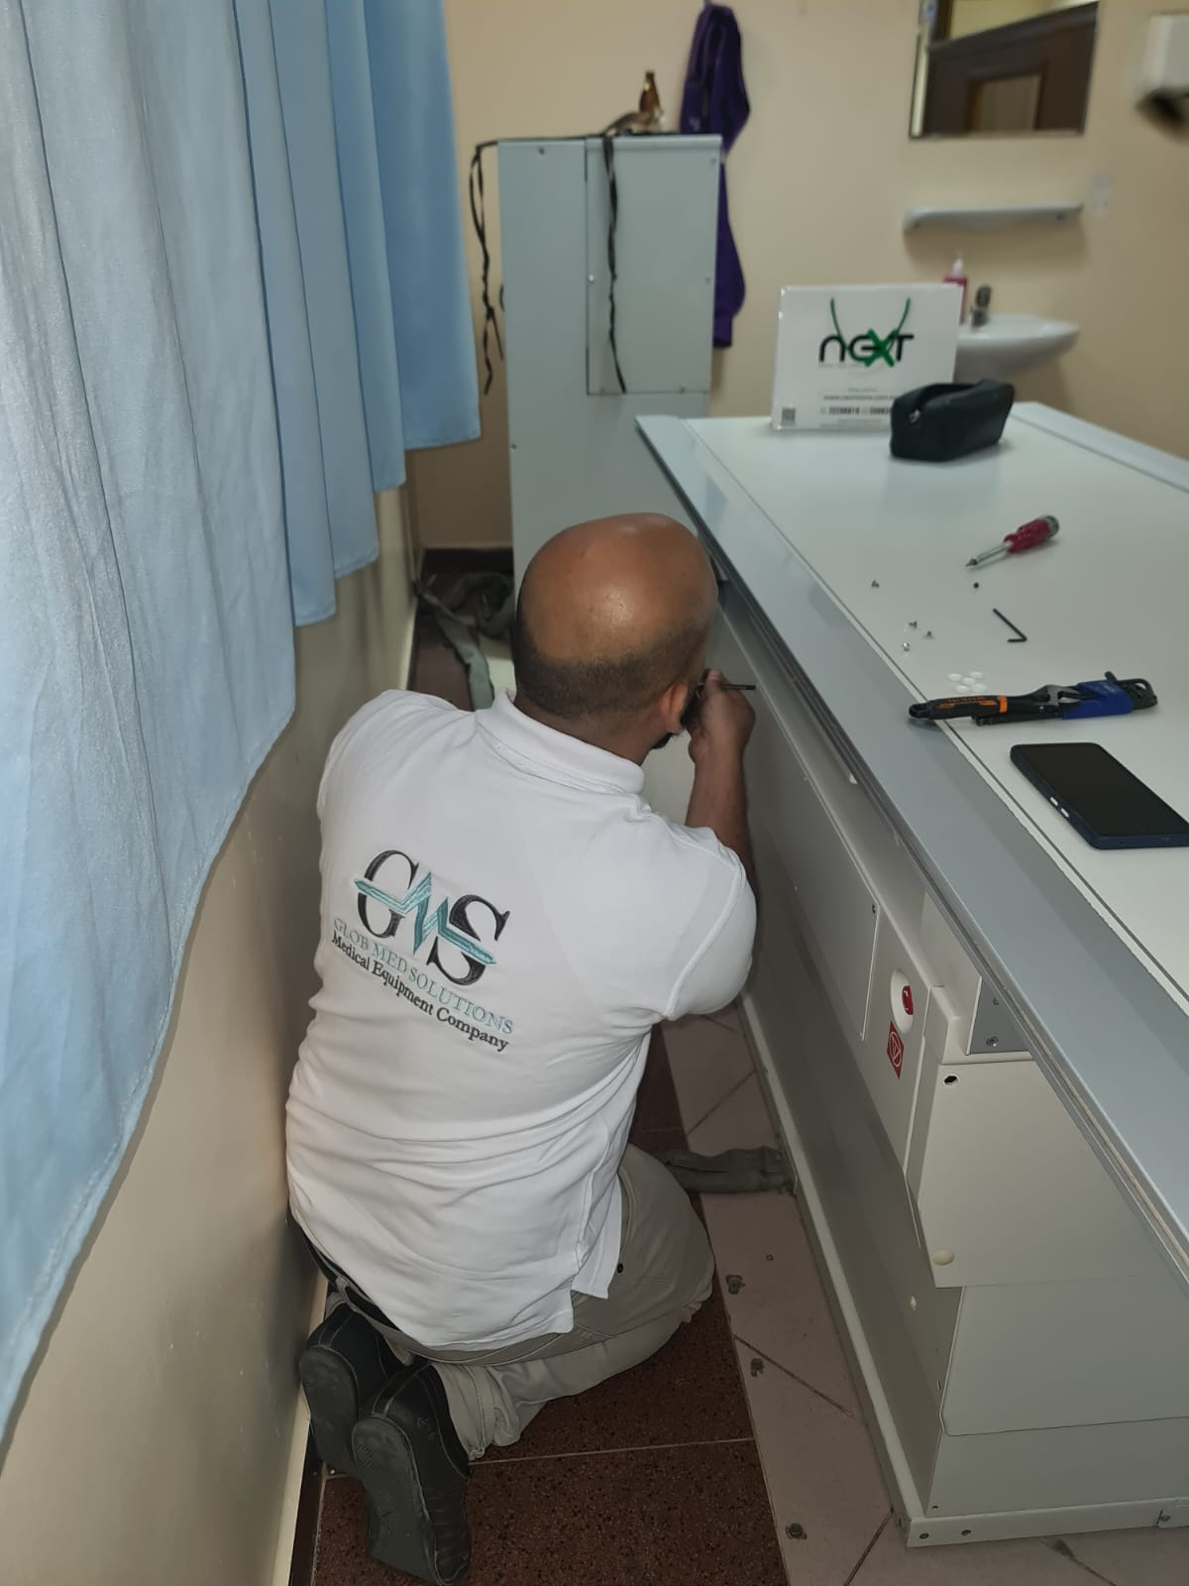
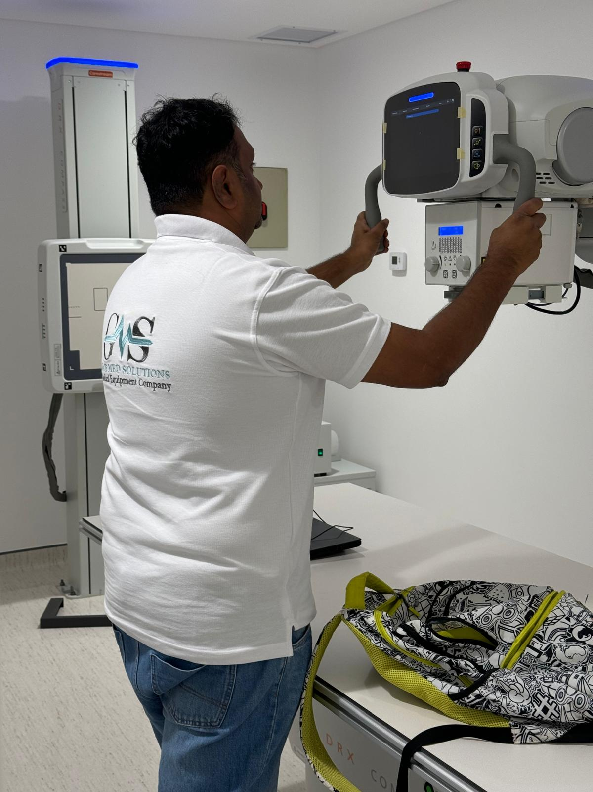
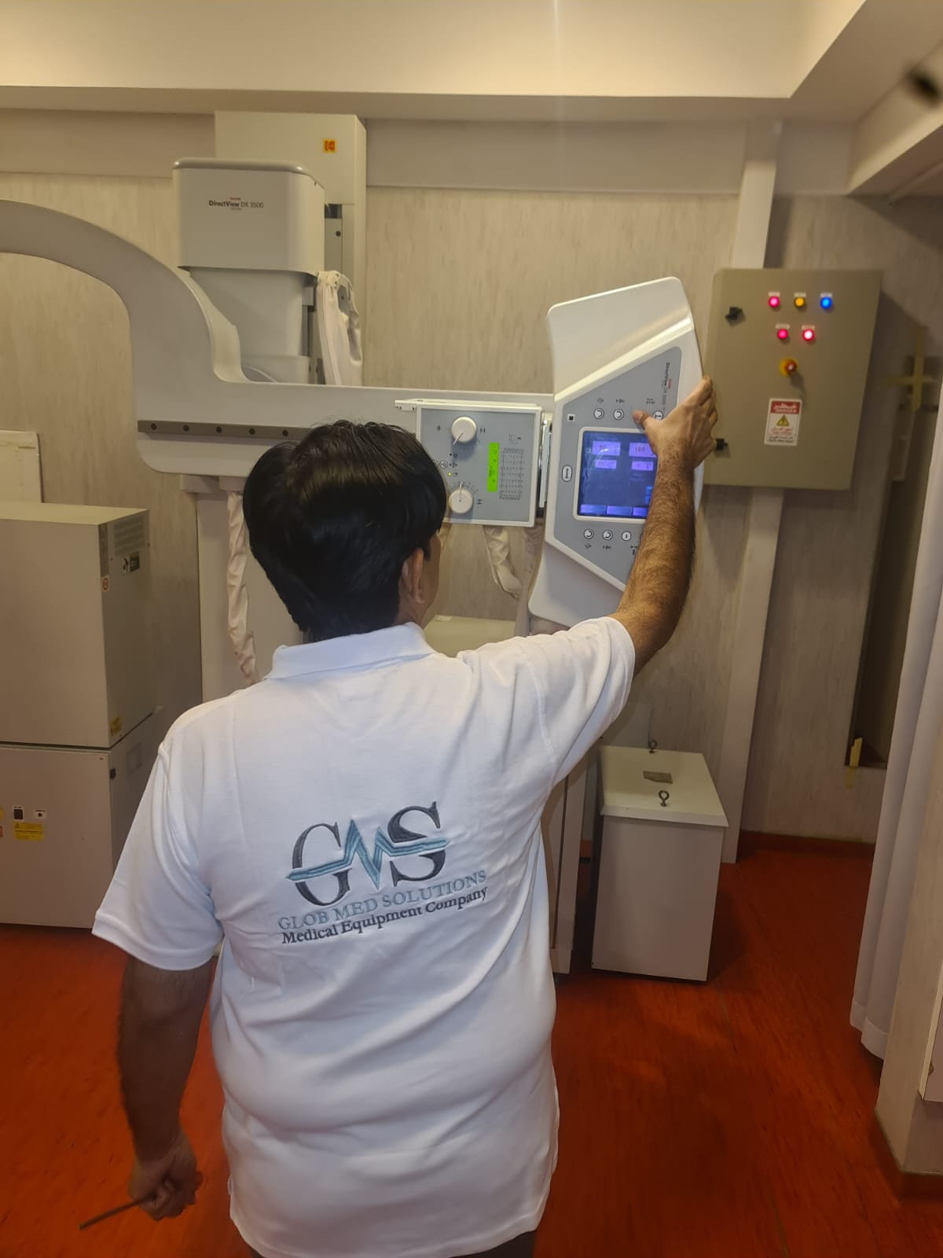
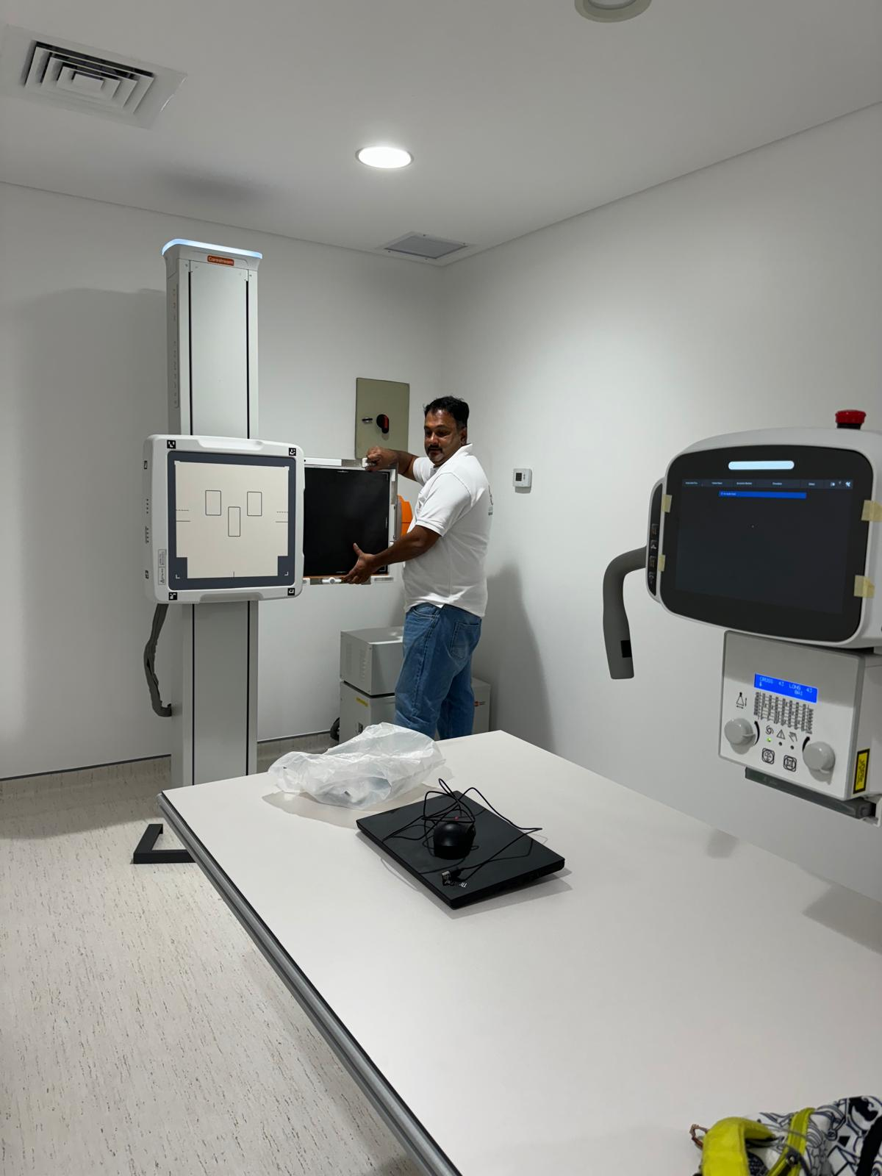
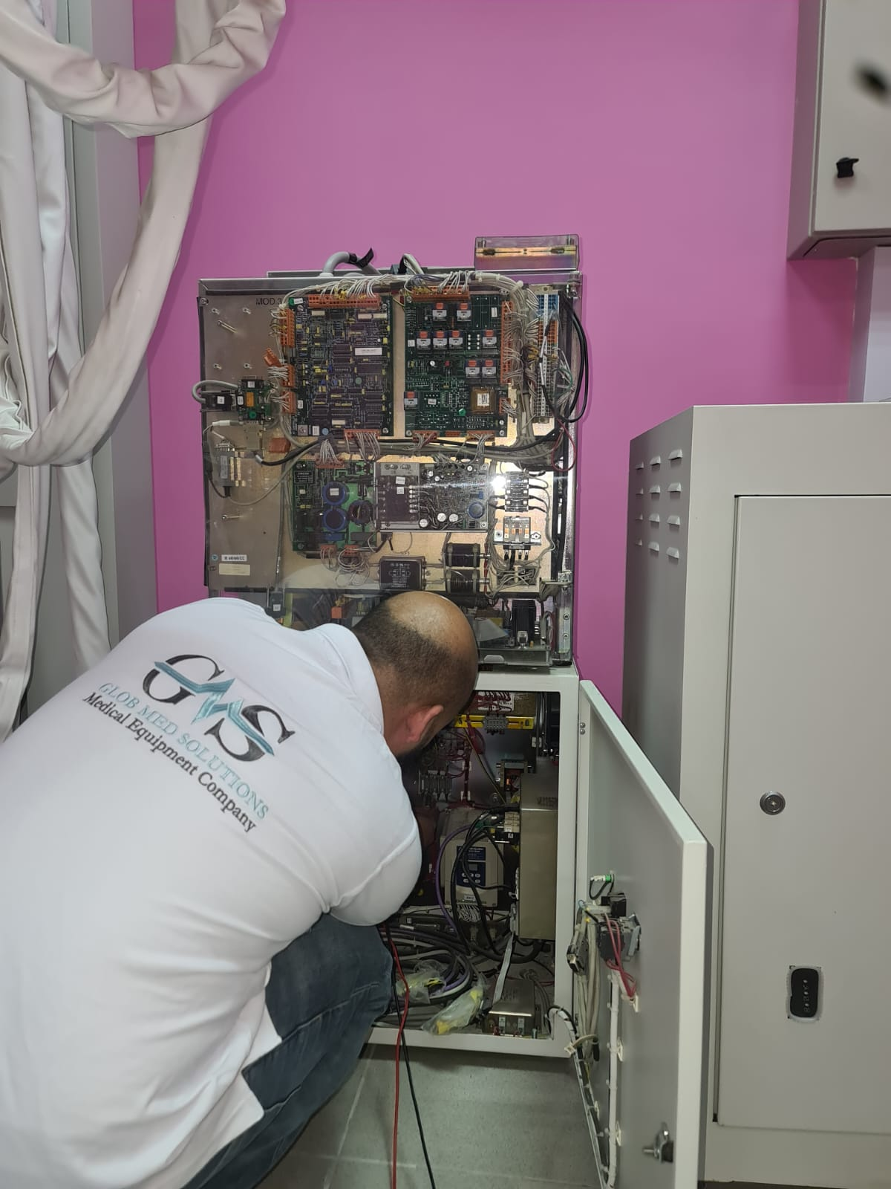
Qualified and dedicated After Sale Service team, Trained for prompt response and smart solutions

Slide 12


GLOB MED SOLUTIONS Co.
Kuwait - Salmiya - Salem Al-Mubarak St.
Symphony Mall Office tower - Floor 3
Office 1 Tel.& Fax (+965) 22280934
We are always happy to hear form you

